Slide 1
E-learning Website Auditing and Digital Marketing Implementation
By: Kavya Jain

Slide 2


Strategic Digital Transformation
A Comprehensive Analysis, Website Audit, Technical Redesign Strategy, and Multichannel Marketing Implementation for Elevate Learning.

Slide 3


The Diagnostic Website Audit
An expert audit evaluated Elevate Learning across multiple crucial digital performance indices. The overall benchmark score indicates reliable basic systems combined with significant optimization gaps in mobile rendering, modern search engine structure, and conversion channels.
Audited Performance Vector | Current Score (/100) | Operational Evaluation Status | Priority Tier for Strategic Intervention
Website Design & Consistency | 75 / 100 | Good | Tier 3 — Secondary Visual Rebranding
User Experience (UX) Flow | 72 / 100 | Good | Tier 2 — Navigation Streamlining
Content Quality & Scope | 70 / 100 | Good | Tier 3 — Pillar Hub & Spoke Expansion
Mobile Optimization | 68 / 100 | Needs Improvement | Tier 1 — High Urgency Design Restructure
On-Page SEO Execution | 65 / 100 | Needs Improvement | Tier 1 — Indexation & Keyword Mapping
Technical SEO & Core Vitals | 60 / 100 | Needs Critical Support | Tier 1 — Performance & Asset Compression
Conversion Rate Optimization (CRO) | 58 / 100 | Needs Critical Support | Tier 1 — Simplified Funnels & Smart CTA

Slide 4


Core UX & UI Challenges
User Experience (UX) Bottlenecks
User Interface (UI) Bottlenecks
Complex Navigation: The current interface is cluttered with excessive course levels and menus, leading to high abandonment rates.
Visual Inconsistency: Colors are implemented without unified branding parameters. Readability suffers due to uneven typographical hierarchy.
Weak Homepage Structure: Fails to clearly establish a distinct, instant value proposition. Primary action triggers are lost in surrounding visual noise.
Static Graphics: Call-to-action triggers are visually generic and fail to stand out, lacking state transitions or visual weight.
Cluttered Funnel Path: Critical information, such as instructor background, learner testimonials, and curriculum data, is deeply buried or altogether absent.
Form Complexity: Enrollment and inquiry forms demand excessive data fields, reducing mobile user sign-ups and generating high friction.

Slide 5

Mobile Performance Gaps
The Necessity of a Mobile-First Restructure
68%
Over 50% of targeted online learners discover and consume course content via mobile devices. Elevate Learning's current codebase suffers from unoptimized layouts, tiny click zones, uncompressed media files, and long, multi-step transaction pages.
To secure search engine visibility and improve user retention, the redesign must align with Google's strict Core Web Vitals standards: Largest Contentful Paint (LCP) under 2.5 seconds, First Input Delay (FID) under 100 milliseconds, and Cumulative Layout Shift (CLS) under 0.1.
MOBILE OPTIMIZATION RATING

Slide 6

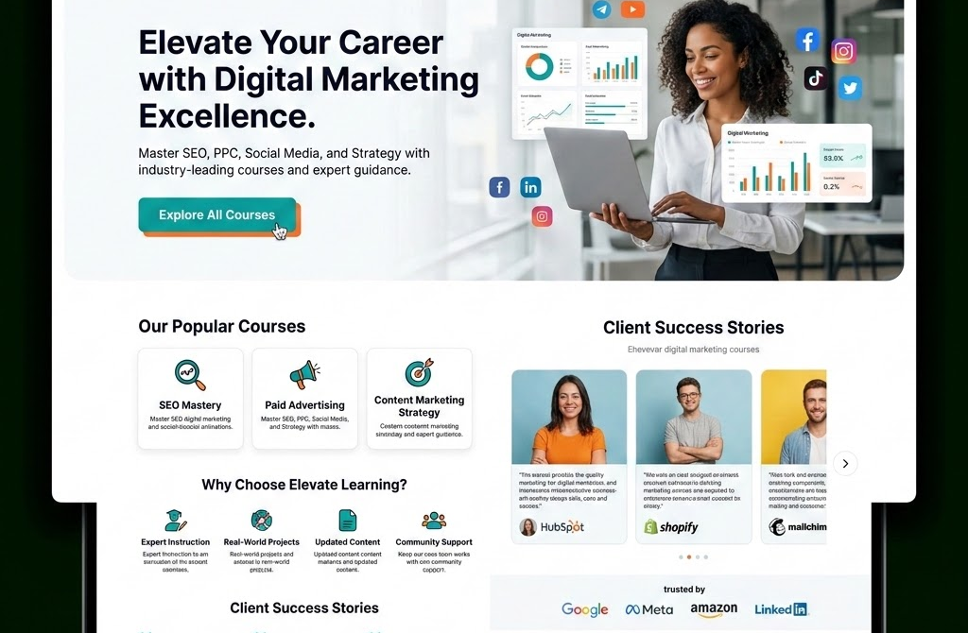
Competitor Landscape Analysis
Establishing an Indisputable USP
A benchmark study against Udemy, Coursera, and Skillshare reveals clear market divisions. While Udemy commands volume and Coursera offers academic credibility, they struggle to provide end-to-end career guidance.
The Elevate Learning Edge: The redesign and positioning must highlight our unique career ecosystem. We offer high-quality certifications coupled with live projects, professional mentors, resume building, and direct placement support.
By shifting focus from passive video repositories to active career acceleration, we bypass direct pricing competition with volume providers.

Slide 7









Proposed Website Redesign
Personalized Pathways
Simplified Usability
Amplified Trust
Integrates a smart Career Path Selector that classifies visitors as Students, Professionals, or Career Switchers, dynamically serving targeted program suggestions.
Reorganizes navigation menus, creates predictive search bars with auto-complete, and clusters individual lessons into structured, milestone-based learning paths.
Features learner reviews, mentor credentials, historical placement statistics, exit-intent offerings, and validation logos from prominent hiring partners directly on the homepage.

Slide 8

Mobile-First Redesign Strategy
Sub-3 Second Load Targets
To eliminate high bounce rates, we are transition from desktop scaling to a native mobile-first architecture.
Strategic engineering tasks include aggressive asset compression, code minification, lazy loading implementation, and robust Content Delivery Network (CDN) routing.
All core enrollment flows will be simplified to a single-screen, touch-friendly sequence to capture impulse mobile conversions.

Slide 9
Strategic SEO Playbook
On-Page Metadata Restructure: Standardize a robust meta-tagging methodology. We will rewrite generic title tags to targeted formats (e.g., "Digital Marketing Course | Elevate Learning") and insert highly persuasive meta descriptions containing localized intent keywords.
The Content Cluster Framework: Design high-authority 'Pillar Pages' centered on main curriculum offerings (e.g., Data Science, Digital Marketing). These are linked directly to supporting educational blog articles to systematically accumulate organic authority.
Authoritative Link Building: Publish targeted articles on high-authority channels like Medium, LinkedIn, and HubPages. Support this with trusted web directory submissions and active engagement in community hubs (Quora/Reddit) to grow domain rating.
Technical Diagnostics & Markup: Deploy detailed Schema Markups (Course, FAQ, Breadcrumb, and Review schema) to enable descriptive search results. Set clean, structured URLs and strictly manage sitemap/robots.txt configurations.

Slide 10


Multi-Channel Implementation
Paid Advertising
Automated Nurturing
Social Media Engine
Launches conversion-focused Google Search campaigns targeting high-intent long-tail keywords, coupled with engaging Meta visual and carousel remarketing campaigns.
Deploys event-based email drip workflows. This sequence guides leads from initial webinar registration to personalized course suggestions and enrollment incentives.
Maintains a steady posting calendar on LinkedIn and Instagram. Focuses on educational concepts, placing student achievement videos and live mentor interviews front and center.

Slide 11
Implementation Timeline
Weeks 3-4
Design & Wireframes: Establish clean information architecture, responsive layouts, and unified typography guidelines.
Weeks 7-10
QA & Launch: Execute speed optimizations, cross-device testing, and launch campaigns.
Weeks 1-2
Weeks 5-6
Research & Audit: Execute target persona mapping, deep competitor analysis, and detailed usability tests.
Development & SEO: Build core web pages, write targeted SEO metadata, and set up tracking events.

Slide 12
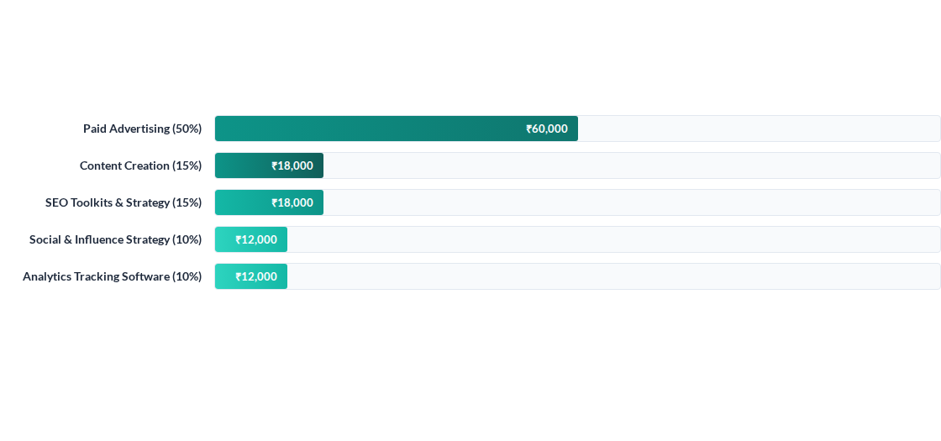
Monthly Budget Allocation
Total Proposed Monthly Marketing Budget: ₹1,20,000. Designed to support sustainable customer acquisition tracks.

Slide 13

Core KPI Targets (6-Months)
Key Performance Metric | Current baseline | 6-Month Redesign Target | Projected Change & Impact
Monthly Organic Traffic | 8,000 visitors | 12,000 visitors | + 50.0% traffic acquisition scale
Total Website Traffic | 20,000 visitors | 30,000 visitors | + 50.0% visual footprint expansion
Monthly Lead Volume | 500 inquiries | 700 inquiries | + 40.0% pipeline generation boost
Course Enrollments | 200 enrollments | 300 enrollments | + 50.0% direct monetization lift
Average Website Bounce Rate | 55% average | Below 40% | - 15.0% bounce rate decrease
Conversion Rate (CRO) | 2.5% rate | 4.0% rate | + 60.0% processing efficiency

Slide 14


